Slide 1
Design Pattern Strategy Pattern
Team 2
12L-4276 Ghayyur Ali
15L-4113 Lubaina Zubair
15L-4330 Hasan Saleem
15L-4377 Fahad Tariq
15L-4406 Tehreem Aftab
15L-4375 Ghassan Faheem

Slide 2
Pattern Name: Strategy
Classification:
Object Behavioral
Scope: It’s Object Scope.
Purpose: It’s Behavioral as it deals with the interaction between objects.
Notes:
Essence: The Strategy pattern allows us to select a specific algorithm at runtime.

Slide 3
Intent
Define a family of algorithms, encapsulate each one, and make them interchangeable. Strategy lets the algorithm vary independently from clients that use it.

Slide 4
Also Known as
Policy Pattern

Slide 5
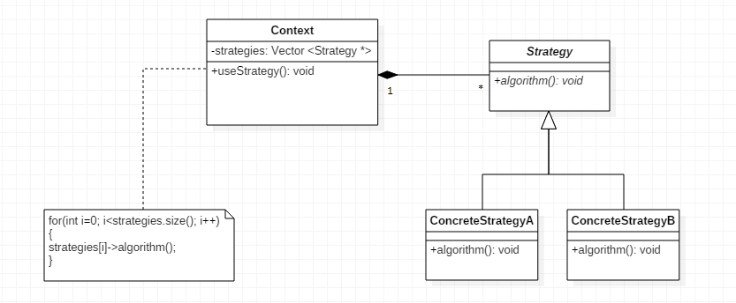
Structure

Slide 6
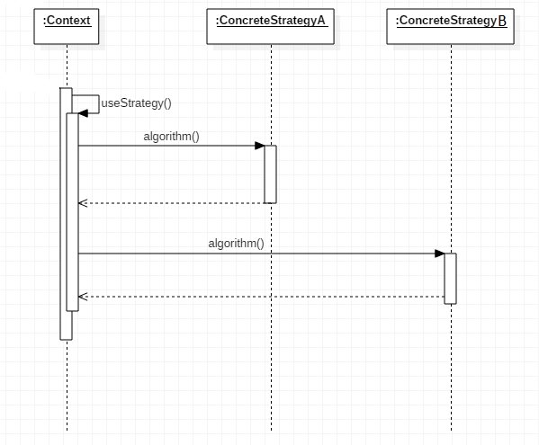

Slide 7
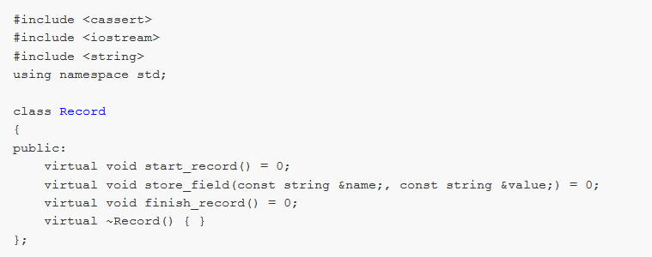
Sample Code
//abstract strategy

Slide 8
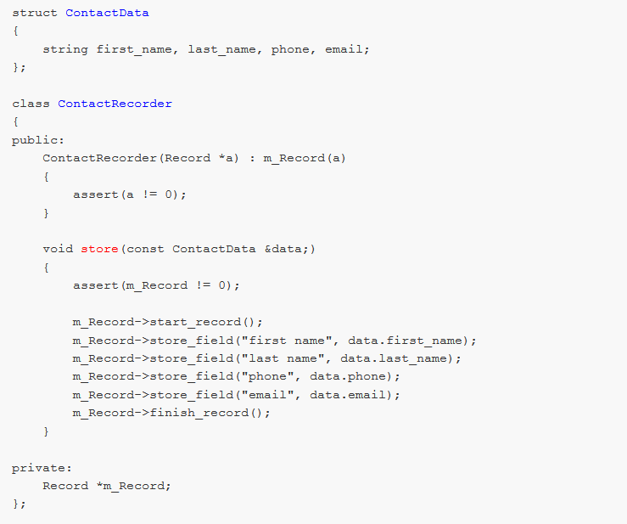
//Context
//useStrategy method

Slide 9
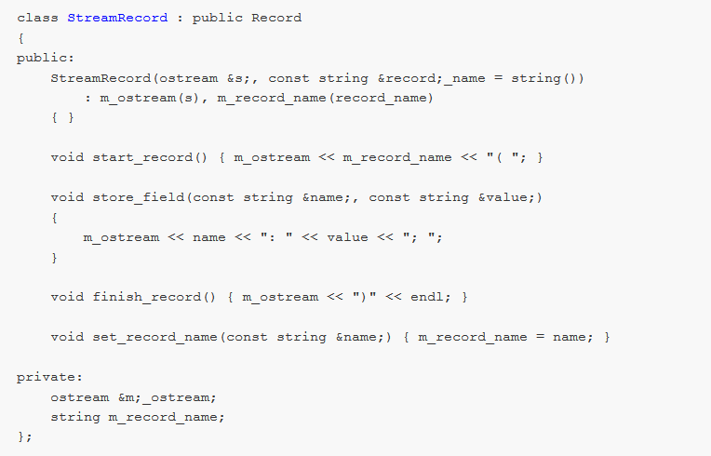
//ConcreteStrategyA

Slide 10
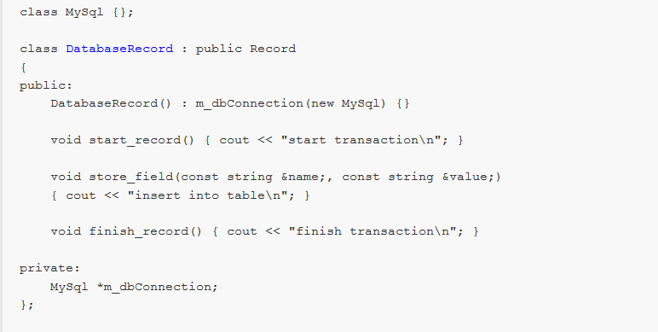
//ConcreteStrategyB

Slide 11
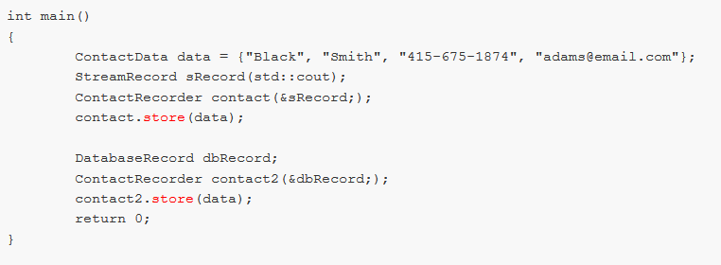

Slide 12
